Slide 1
Running Dashboard
https://github.com/TaylorFurman/runningDashboard
Project by: Shane McDonald and Taylor Furman

Slide 2
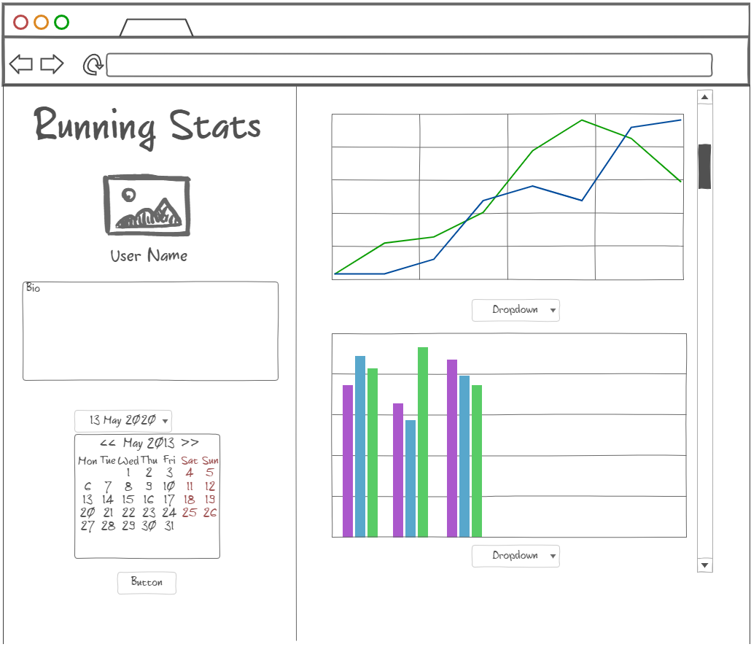
Project Overview
Create a dashboard that would take in data from Strava’s API and visualize that data using graphs and GIS mapping
Wireframe mock (right) was made prior to starting project

Slide 3
Technologies Used (Backend)
Express.js
Node.js
Postgresql
Elephant SQL for hosting
Beekeeper for interaction
Axios
Pg-promise
Postman (for debugging)

Slide 4
Technologies Used (Frontend)
Chart.js
Axios & Jquery
Leaflet
Polyline decoder

Slide 5
API Call and Data Storage
Strava API
*Access token would expire after 2 hours, therefore a refresh token was needed to get a fresh access token
Axios call to get API data
*Refresh Token needed to get Access Token to get API data*
Browser
JSON file
postgresql DB
Axios call the JSON file to produce charts and polyline data
Caching - To access the data in the front end and to reduce number of API calls

Slide 6
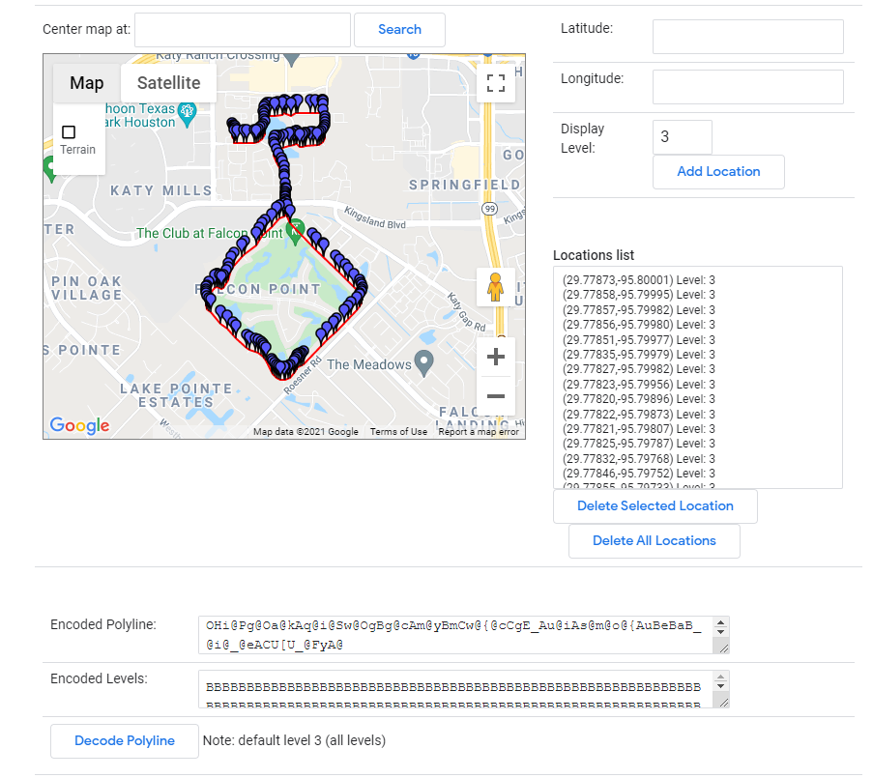
Polyline decoding
Polyline data is presented in an encoded manner used by google
Example of Encoded Polyline Below:
adwtD`}ugQ\K@Y@CHE^BNDFs@DwBCm@@cCGg@Me@[_@Qe@_@Uc@Sg@Dc@Hg@@e@F]Yg@Bc@KWe@Eg@A{AGk@CyASa@Dk@`@oAg@qAEk@EuEDyACyBBKPEf@C|A?fBSd@Kn@Ad@@b@N`@VV`@Rf@DZAlACh@FtA@NRd@Gh@e@z@CRRd@Nh@@f@T~AJjAAj@Fh@b@L~@C`@KbA]dAk@jAs@^QhAUlAGx@?f@A|AOhA@RIC?v@Ht@BPAf@Gb@Kd@OvAq@fJqKt@}@xAsBXYhDiEz@aApAeBp@o@vAmBbBgB^W`@Qn@C^FXH`@RPNb@d@rAdBx@x@t@`AjCrC^n@fBtBbBhBhGnHVb@J`@@VRVb@F\R\\r@`APb@Lf@DXG`AG^Ub@Wb@]\a@ZsDbB_@X]\Y^Yp@Oj@_@hB[r@qCvDs@z@cBjBsAjBeDpDY^]Xa@Rc@F]@e@EWGy@k@gBcBM_@?OHi@Pg@Oa@kAq@i@Sw@OgBg@cAm@yBmCw@{@cCgE_Au@iAs@m@o@{AuBeBaB_@i@_@eACU[U_@FyA@
Copy and paste the data above into the developers.google link, the actual route will be displayed
A decoder was used in order to plot the polyline data
https://developers.google.com/maps/documentation/utilities/polylineutility

Slide 7
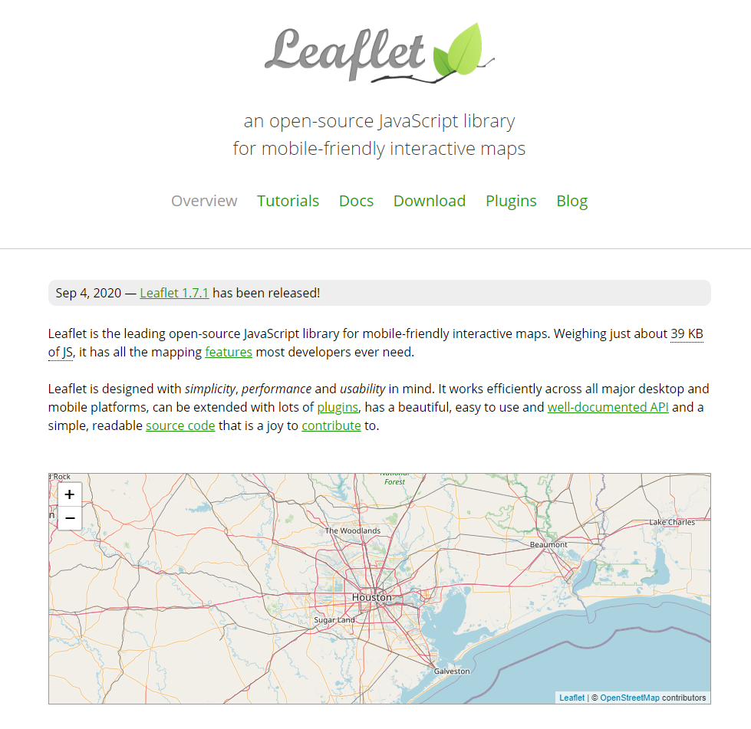
Leaflet
Open source library for interactive mapping
Using the stored JSON from the API, plot the data based on that individual dataset
https://leafletjs.com/

Slide 8
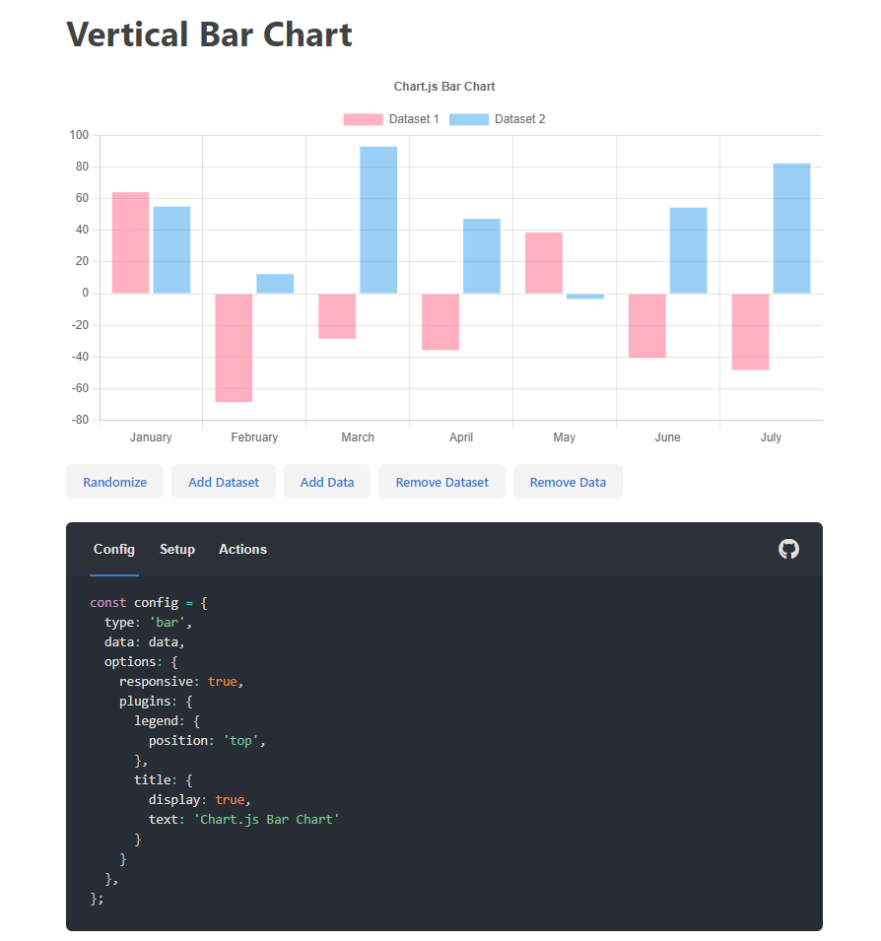
Chart.JS
Flexible charting for javascript applications
Using the stored JSON from the API, plot the data based on that individual dataset
https://www.chartjs.org/

Slide 9
Problems encountered
Accessing API & API access token expiring after 2 hours
Postman used to debug
Storing API data into database
Needed to store all data as strings, not integers
Accessing database from the frontend
Could not figure out, caching method was used as fall back
Storing database data as JSON file to access in front end
Needed to store in frontend files to access with front end javascript
Making data dynamic (switching from one dataset to another)
Map function was used inside axios call to access data that was relevant to that data’s date
Was able to then change data dynamically with dropdown select
API GPS coordinates do not have the same number of digits for longitude/latitude
Causes error in inspector, does not break app

